Slide 1
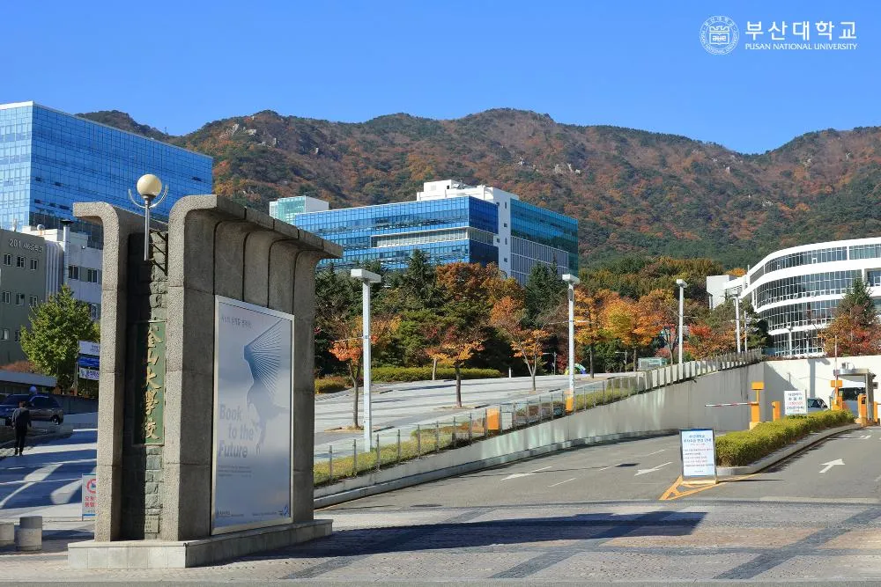


CAMPUS Asia EEST
26th CSS-EEST
Opening Ceremony

Slide 2
Opening Ceremony
YANG Minjong
Director,
PNU International

Slide 3
Opening Ceremony
WANG Qian
Director, CA+
Shanghai Jiao Tong University

Slide 4
Opening Ceremony
WANG Dong
Director, Global Engagement Office,
IGSES, KU

Slide 5
Opening Ceremony
ZAINI Bin Ahmad
Dean, Faculty of Mechanical Engineering

Slide 6
CAMPUS Asia EEST
26th CSS-EEST
Orientation

Slide 7
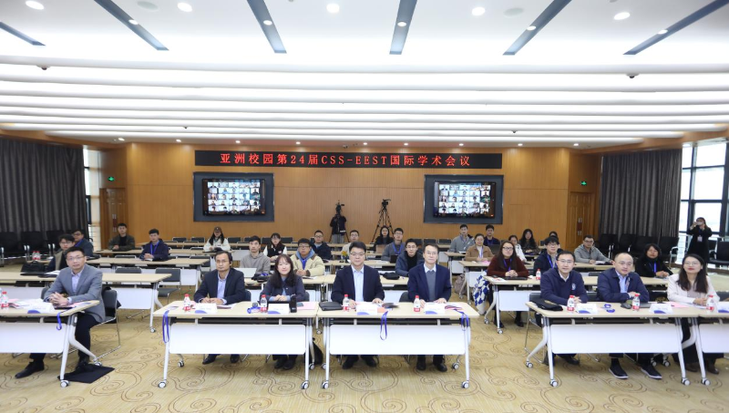
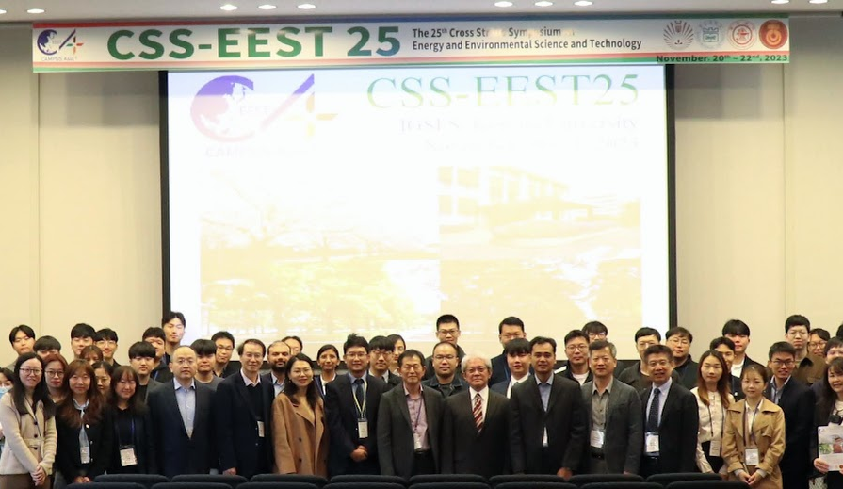
Introduction of CSS-EEST
1999
2022
2024(Now)
1st Cross Straits Symposium
on Materials, Energy and
Environmental Science (CSS)
24th CSS-EEST at
Shanghai Jiao Tong University,
Including UTM
26th CSS-EEST at
Pusan National University
(PNU 51, KU 14, SJTU 26, UTM 8)
2013
2023
2026 ?
Renamed to the Cross Straits Symposium on Energy and
Environmental Science and Technology (CSS-EEST)
25th CSS-EEST at
Kyushu University
28th COS-EEST
Renamed to
Cross Ocean Symposium

Slide 8
Schedule: Day 1: Dec. 2nd (Mon)
Guidebook p.12~13
Time | Session | Venue
09:15 - 09:45 | Opening Ceremony | 303-207-Auditorium
09:45 - 10:00 | Orientation | 303-207-Auditorium
10:00 -10:30 | Keynote #1 (Energy) Presenter: YEOM Eunseop (PNU), Chair: LEE Donggeun | 303-207-Auditorium
10:30 -10:45 | 15-min break (※ Room 303-904 is prepared as a lounge for professors)
10:45 - 12:00 | Oral Sessions #1 & #2 (Materials) | 303-207, -531
11:00 - 13:30 | PDCA Meeting & Lunch | 303-505
12:00 - 13:00 | Lunch
13:00 - 13:30 | Keynote #2 (Energy) Presenter: HANG Tao (SJTU), Chair: HAN Dong | 303-207-Auditorium
13:30 - 13:45 | 15-min break
13:45 - 15:45 | Oral Sessions #3 & #4 (Environment, Energy) | 303-207, -531
15:30 - 16:00 | Tea Time (10 Faculties) with the Vice President of PNU at PNU headquarter | 205-4F
15:45 - 16:00 | 15-min break
16:00 - 18:00 | Poster presentation (18 posters) | 303-B106
17:00 - 17:30 | UTM-PNU Master's Dual Degree Signing Ceremony | 303-505
18:00 | Faculty Dinner | Nongshim Hotel, Geumjung Cafeteria

Slide 9
Day 1 Special announcement for professors
Time | Session | Venue | Reviewer
10:45 - 12:00 | Oral Session #1 (5) : Materials | 303-207-Auditorium | SJTU: Prof. HAN Dong
 | Oral Session #2 (5) : Materials | 303-531 | SJTU: Asso. Prof, ZHENG Zhen
11:00 - 13:30 | PDCA Meeting & Lunch | 303-505 | All invited
13:45 - 15:45 | Oral Session #3 (8) : Environment | 303-207-Auditorium | UTM: Prof. Aminuddin Saat
 | Oral Session #4 (8) : Energy | 303-531 | SJTU: Asso. Prof. JIANG Zhi
15:30 - 16:00 | Tea time with Vice President of PNU | 205-4F | 10 Professors invited
16:00 - 18:00 | Posters (18) | 303-B106 | 3 PNU professors
17:00 - 17:30 | UTM-PNU signing ceremony | 303-505 | All invited
18:00 | Faculty Dinner | Nae-Dang, Hotel | All invited
Prof. HAN Dong & Prof. ZHENG Zhen: Plz come to room 505 for lunch & PDCA after the sessions
Others are asked to come room 505 to attend PDCA meeting w/ lunch on time
10 professors (see the next slide) are invited for tea time with the vice president of PNU
; Plz, come to the main door of 207 auditorium by 15:15 (15 min earlier)
All professors are asked to come to room 505 to join in the signing ceremony on time, and then move to Hotel Nongshim together w/ taxi

Slide 10
10 Professors invited to the 1st tea time
1 | Prof. | YANG Minjong | Vice president for International Affairs | PNU
2 | Prof. | LEE Donggeun | Director, CA+, Mechanical Engineering | PNU
3 | Prof. | HARATA Akira | Deputy Director General, Q-AOS, KU (Institute for Asian and Oceanian Studies) | KU
4 | Prof. | MIYAZAKI Takahiko | Director, CA+, Mechanical and Systems Engineering | KU
5 | Prof. | WANG Dong | Director, Global Engagement Office, IGSES, Device Science and Engineering | KU
6 | Mr. | SONG XUMING | Chairman, School Council, Low Carbon College | SJTU
7 | Assoc. Prof. | WANG QIAN | Director, CA+, Director, Internation Affairs Office | SJTU
8 | Prof. | HANG TAO | Vice Dean, School of Materials Science and Engineering | SJTU
9 | Assoc. Prof. | Che Rozid Bin Mamat | Director, Office of Strategic and Corporate Affairs | UTM
10 | Assoc. Prof. | Ir. Ts. Dr. Zaini Bin Ahmad | Dean, Faculty of Mechanical Engineering | UTM

Slide 11
Schedule: Day 2: Dec 3rd (Tue)
Guidebook p.12~13
Time | Session | Venue
9:30-10:00 | Keynote #3 (Environment) Presenter: THU Kyaw (KU), Chair: Prof. WANG Dong | 303-207-Auditorium
10:30 - 12:00 | Oral Sessions #5, #6, #7 | 303-207-Auditorium, 408, -B106
12:00 - 13:00 | Lunch
13:00 - 13:30 | Keynote #4 (Environment) Presenter: Mohd Shafry Mohd Rahim(UTM), Chair: Prof. Aminuddin Bin Saat | 303-207-Auditorium
13:30 - 13:45 | 15-min break
13:45 - 15:45 | Oral Sessions #8, #9, #10 | 303-207-Auditorium, B106, -408,
15:00 - 16:00 | Tea Time(All Faculties) with the President of PNU at PNU headquarter | 205-5F
15:45 - 17:00 | 15-min break
17:00 - 18:00 | Closing Ceremony | 303-207-Auditorium
18:00 | Farewell party | 303-B106

Slide 12
Day 2 Special announcement for professors
Time | Session | Venue | Reviewer
10:30 - 12:00 | Oral Session #5 (6) : Materials | 303-207-Auditorium | SJTU: Prof. HANG Tao
 | Oral Session #6 (6) : Environment | 303-408 | KU: Prof. WANG Dong
 | Oral Session #7 (6) : Energy | 303-B106 | KU: Prof. THU Kyaw
13:45 - 15:45 | Oral Session #8 (6) : Materials | 303-207-Auditorium
 | Oral Session #9 (4) : Environment | 303-B106 | SJTU: Prof. HE Yiliang
 | Oral Session #10 (7) : Energy | 303-408
15:00 - 16:00 | Tea time with President of PNU | 205-5F | All invited
17:00 - 18:00 | Closing ceremony | 303-207-Auditorium | All invited
18:00 | Farewell party | 303-B106 | All invited
All professors are invited for tea time with the president of PNU
; Plz, come to the main door of room B106 by 14:45 (15 min earlier)
; Prof. Yilliang HE is asked to get out of the session room (B106) exactly at 14:45
All professors are asked to come to the auditorium to join the closing ceremony on time, and the subsequent farewell party in room B106

Slide 13
Professors invited to the 2nd tea time
1 | Prof. | YANG Minjong | Vice president for International Affairs | PNU
2 | Prof. | LEE Donggeun | Director, CA+, Mechanical Engineering | PNU
3 | Prof. | HARATA Akira | Deputy Director General, Q-AOS, KU (Kyushu University Institute for Asian and Oceanian Studies) | KU
4 | Prof. | MIYAZAKI Takahiko | Director, CA+, Mechanical and Systems Engineering | KU
5 | Prof. | WANG Dong | Director, Global Engagement Office, IGSES, Device Science and Engineering | KU
6 | Assoc. Prof. | KYAW Thu | CSS Chair of KU, Mechanical and Systems Engineering | KU
7 | Mr. | SONG XUMING | Chairman, School Council, Low Carbon College | SJTU
8 | Assoc. Prof. | WANG QIAN | Director, CA+, Director, Internation Affairs Office | SJTU
9 | Prof. | HANG TAO | Vice Dean, School of Materials Science and Engineering | SJTU
10 | Assoc. Prof. | JIANG ZHI | Head of CA+, School of Mechanical Engineering | SJTU
11 | Prof. | HE YILIANG | Vice Dean, Low Carbon College | SJTU
12 | Prof. | HAN DONG | School of Mechanical Engineering | SJTU
13 | Assoc. Prof. | ZHENG ZHEN | Director, Quality Promotion Office, Graduate School School of Chemistry and Chemical Engineering | SJTU
14 | Assoc. Prof. | Che Rozid Bin Mamat | Director, Office of Strategic and Corporate Affairs | UTM
15 | Assoc. Prof. | Ir. Ts. Dr. Zaini Bin Ahmad | Dean, Faculty of Mechanical Engineering | UTM
16 | Assoc. Prof. | Aminuddin Bin Saat | Department Head, Thermofulids, Mechanical Engineering | UTM

Slide 14
Oral Presentation
Oral presenters
Upload your presentation file earlier and check it before your scheduled time
Presentation for 11 min + Q&A for 3 min + Author change for 1 min
Student Chairs
Check if all presenters are ready in your session 5 min. before the session starts
Keep the time assigned for your session ; Plz ring a bell when each presentation has been running for 10 min, 1 min. before the end.
Audience
Plz attend all sessions you prepared and actively participate in discussion
Plz select the two best presentations from each oral session through a google platform (see next)

Slide 15
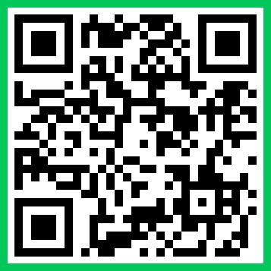
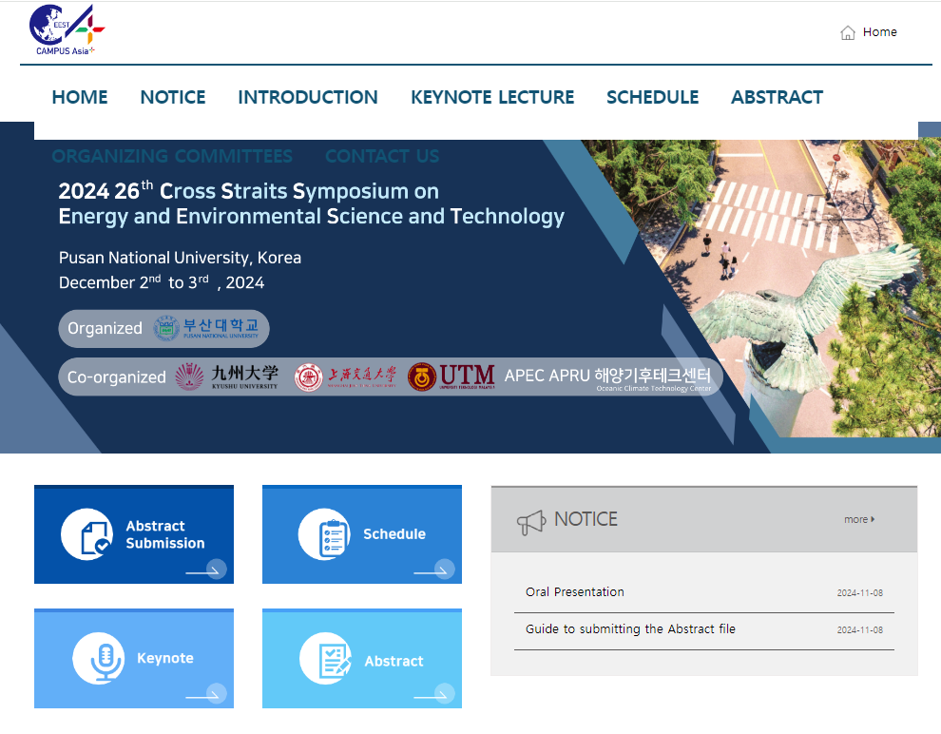
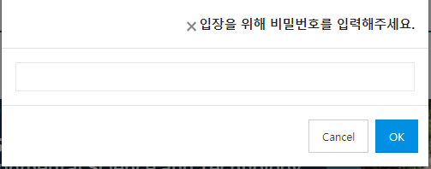
How to select the best oral presentation
Visit CSS 26 homepage (https://public.thinkonweb.com/sites/eest2021w)
or Search w/ “26th CSS-EEST” and then find the website by ThinkOnWeb
QR code to our webpage.
css26
You will be prompted to type a passwd on a new pop-up window.
Then, type “css26” to access the google platform.
Click the tab “Abstract”

Slide 16
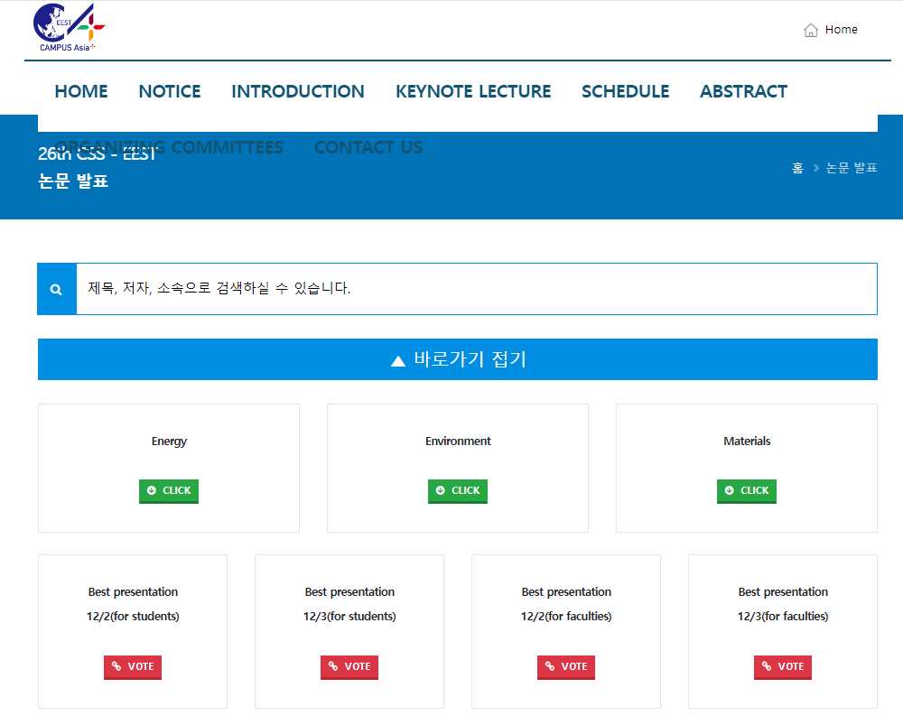
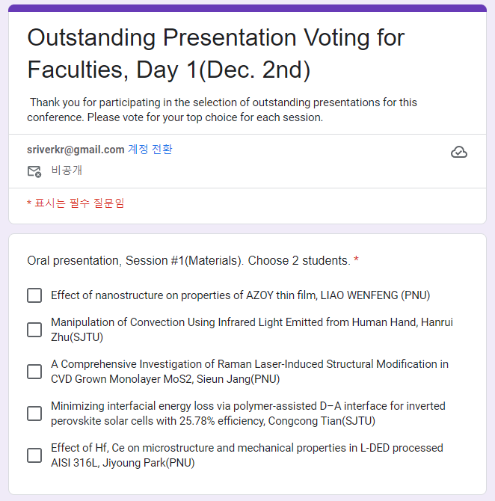
How to select the best oral presentation
Then, you will move onto a voting site below.
Then, you will be prompted to log in with your google ID & passwd
Vote your best presentation in each session on Dec 2nd or Dec 3rd (for students)
Following the instruction, click your best two presentations
This is for Faculty reviewers

Slide 17
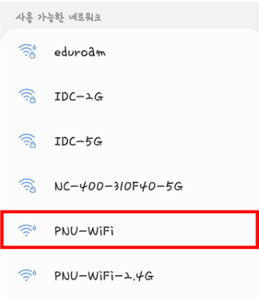
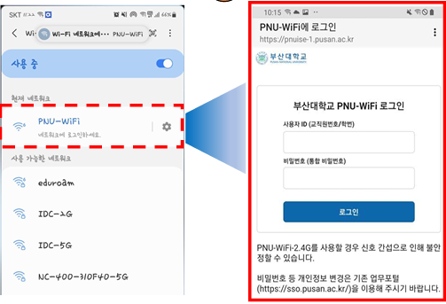
Additional Information
Guidebook p.10~11
사진이나 그림 넣는 곳
Wifi in PNU campus
〮 Please choose “PNU-Wifi”
〮 The ID can be found in the guidebook.
〮 PW: pnucss26

Slide 18

Additional Information
Guidebook p.7
Meal coupon
사진이나 그림 넣는 곳
Three meals will be provided at Geumjeong Cafeteria : Luch & dinner on Dec. 2nd; Lunch on Dec 3rd
Meal coupons are included in your name tag.
Just follow Korean students to know how

Slide 19
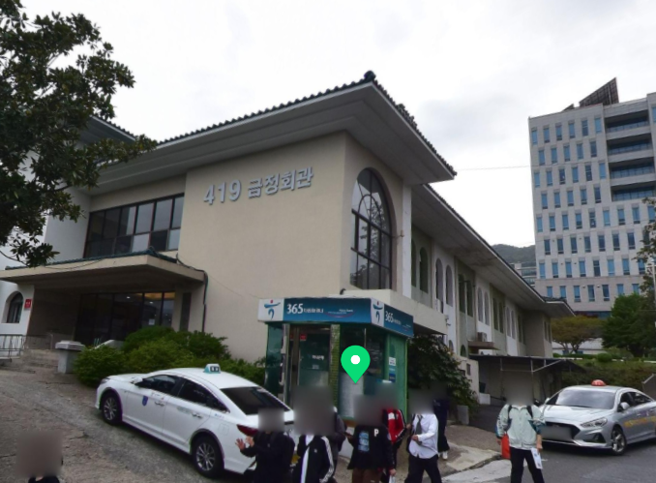
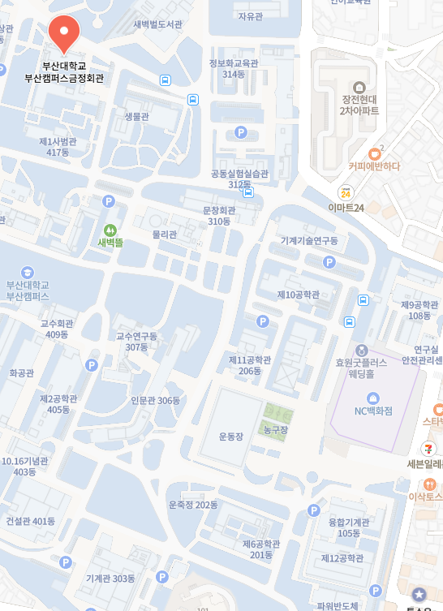
Additional Information
Guidebook p.7
Geumjeong Cafeteria
- Geumjung Cafeteria offers different types of food on the first and second floors.
- Directly go to the second floor. Do not wait in front of two Kiosk machines. Get in to have meals.
- Meal coupons are included in your name tag.
Main Gate
Mechanical Engineering

Slide 20
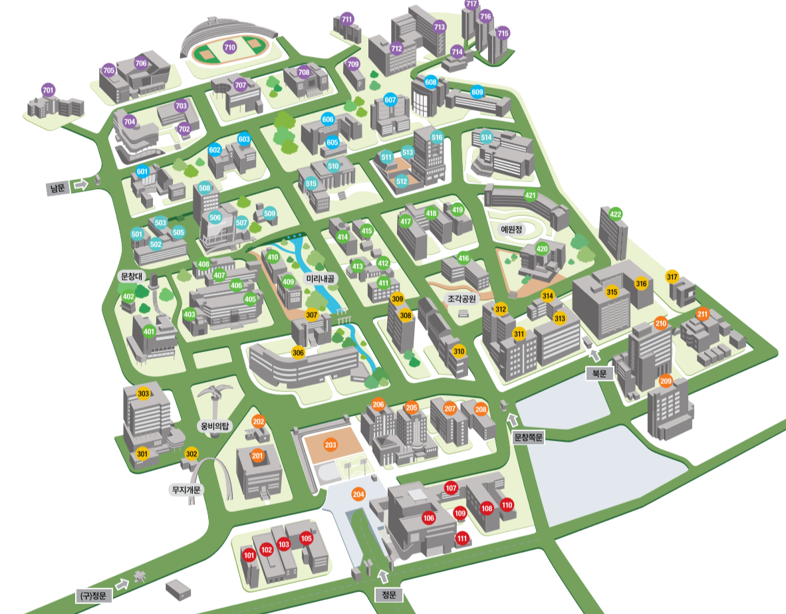
Campus Map
Guidebook p.21
사진이나 그림 넣는 곳
303
Mechanical Engineering Bldg.
419
Geumjeong Cafeteria

Slide 21
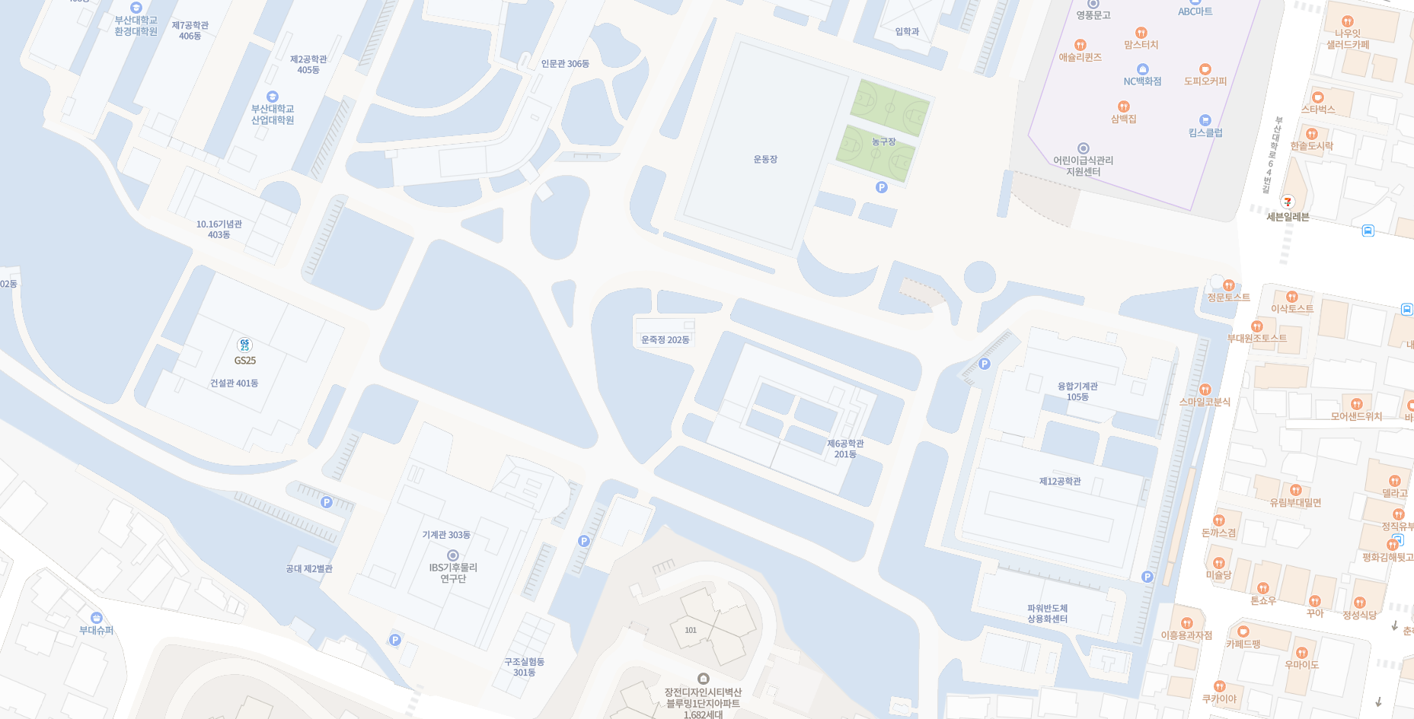
Route maps
Guidebook p.22
Route from PNU Main Gate to PNU School of Mechanical Engineering Bldg (Venue)
Route From ME Bldg to Geumjeong Cafeteria by walking
Geumjung Cafeteria
Main Gate
Mechanical Engineering Building
B1 Floor
Mechanical Engineering Building

Slide 22
Thank you

